Slide 1
CSCNSI 2015
Cluster Hardware Assembly

Slide 2
Introduction
Server Assembly
Cable Installation
Power Budget

Slide 3
Server Assembly

Slide 4
Server Room Considerations
What is the purpose of each node?
Head node
Compute node
Gateway node
I/O node
Test node
Combination?

Slide 5
Server Room
Head Node
To start:
Only one head node
Staging area
Needs video card (sometimes)
Needs hard drive(s)
Typically a “beefy” install
Full featured OS installation

Slide 6
Server Room
Compute Nodes
To start:
Lightweight (minimal) installation
Netboot into installation environment
Installation script to provision node

Slide 7
Cable Installation

Slide 8
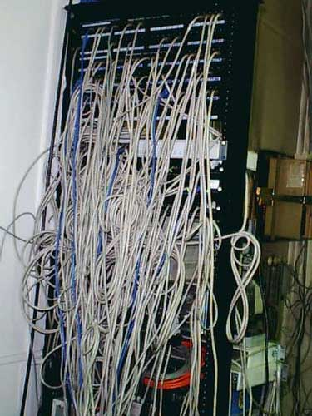
Cable Installation
Computers need cables
Power
Network
Storage
Console
With scale, proper cable management is crucial

Slide 9
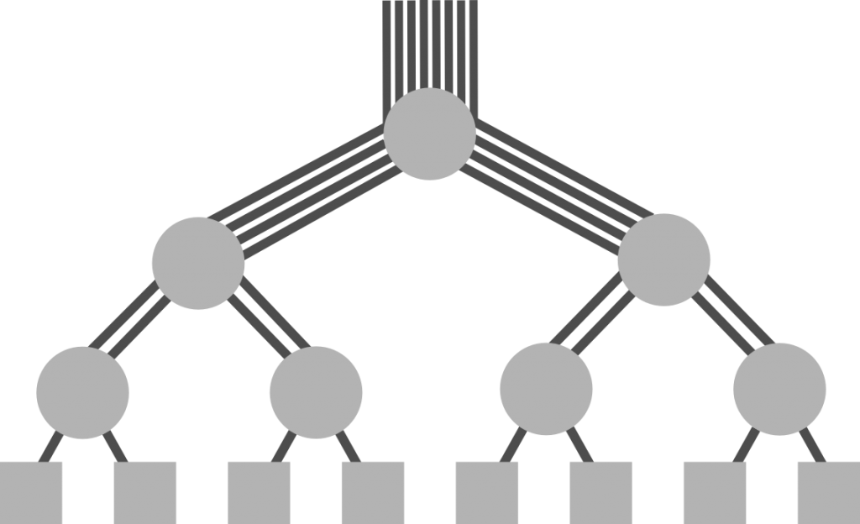
Cable Installation
RoadRunner’s Scale
1728 nodes, each connected with InfiniBand 4X cables
Largest IB switch has 288 ports
Fat tree network

Slide 10
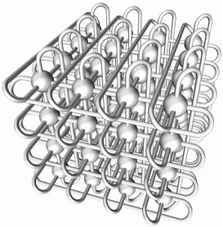
Cable Installation
Cielo Scale
8944 nodes
Cray Gemini 3D torus

Slide 11
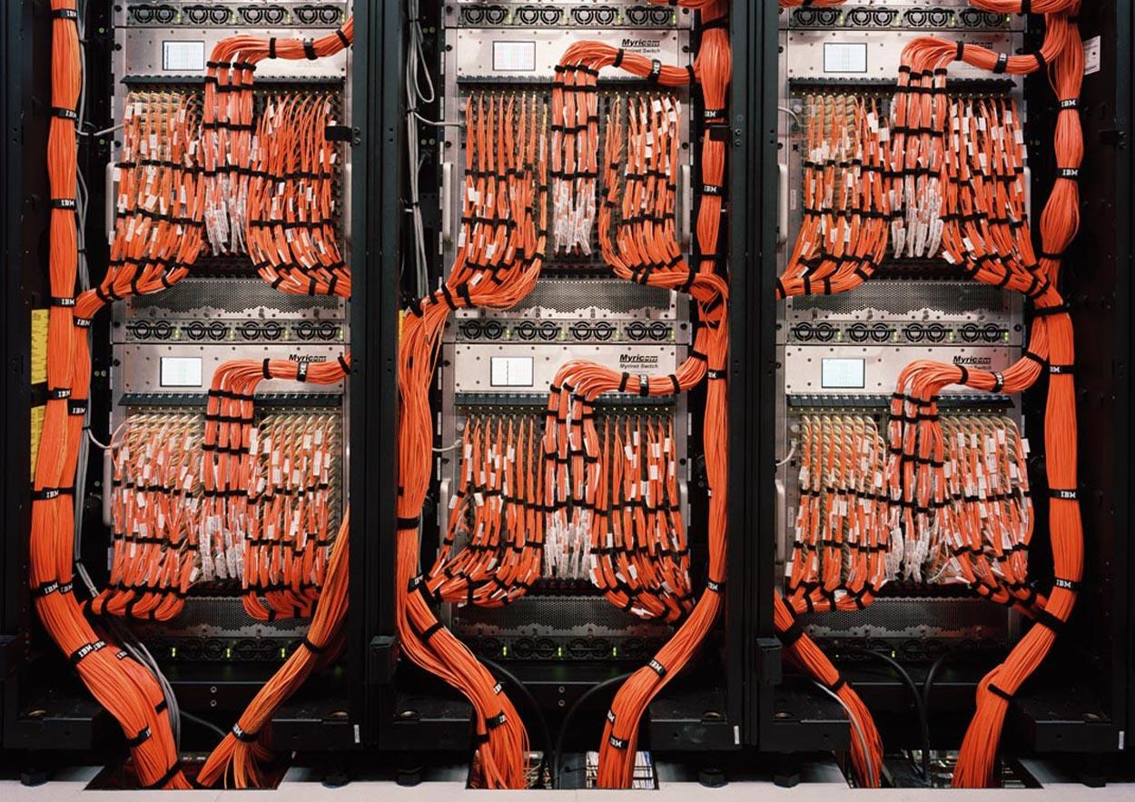
Cabling Standards
Should be:
Labeled
Organized
Bundled

Slide 12
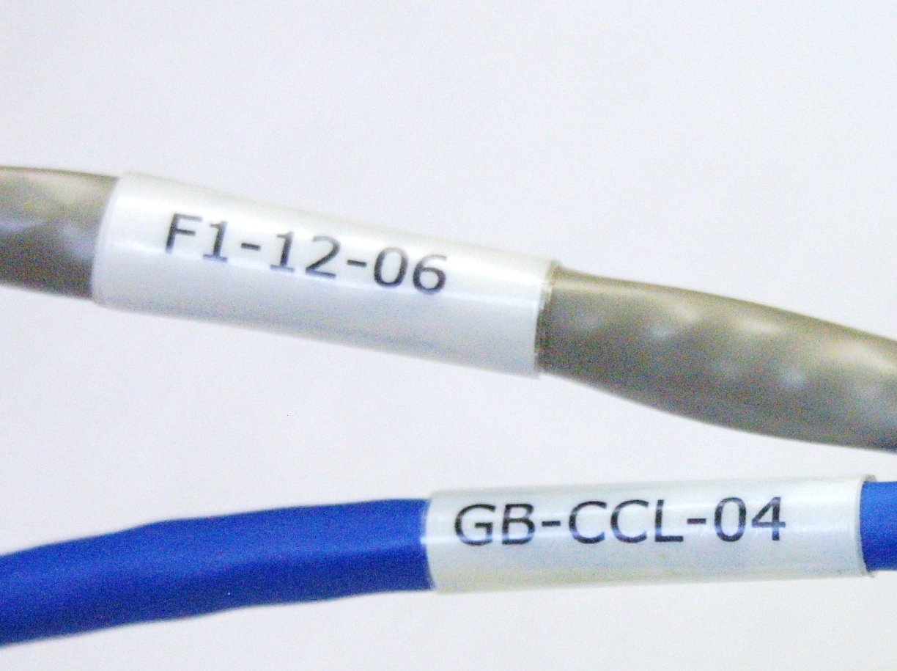
Cabling Labeling
Each cable has two ends; both need labels
Source address
Destination address
Be consistent!
Update when changes occur
Label equipment

Slide 13
Cabling Labeling
Bad Example
From: Rack 7, Ethernet Switch 2, Port 47
To: Rack 5, Node 8, Ethernet NIC 1
Node side:
Cable #712364
Switch side:
Cable #712364

Slide 14
Cabling Labeling
Bad Example
From: Rack 7, Ethernet Switch 2, Port 47
To: Rack 5, Node 8, Ethernet NIC 1
Node side:
R005-N08-E1
Switch side:
R007-ES02-P47

Slide 15
Cabling Labeling
Bad Example
From: Rack 7, Ethernet Switch 2, Port 47
To: Rack 5, Node 8, Ethernet NIC 1
Node side:
R007-ES02-P47
Switch side:
R005-N08-E1

Slide 16
Cabling Labeling
Good Example
From: Rack 7, Ethernet Switch 2, Port 47
To: Rack 5, Node 8, Ethernet NIC 1
Node side:
From: R005-N08-E1
To: R007-ES02-P47
Switch side:
From: R007-ES02-P47
To: R005-N08-E1

Slide 17
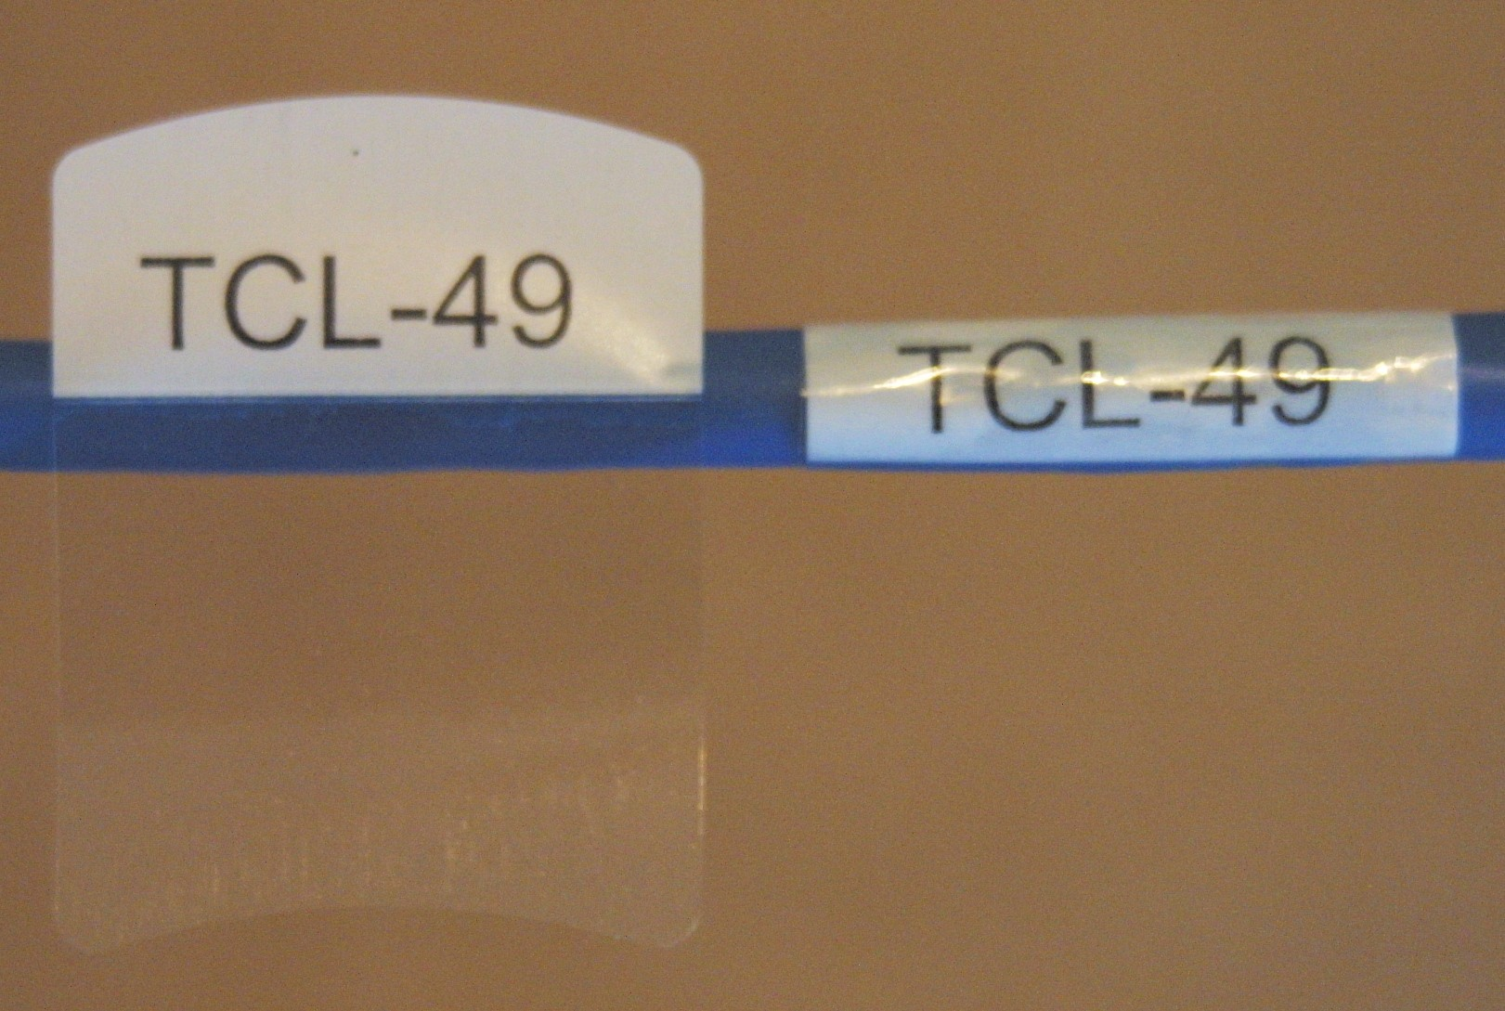
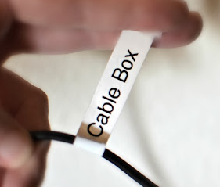
Label Wrapping vs. Flagging
Wrapping
Durable
Easy to pull through
Hard to remove
Flagging
Less tidy
Easier to remove

Slide 18
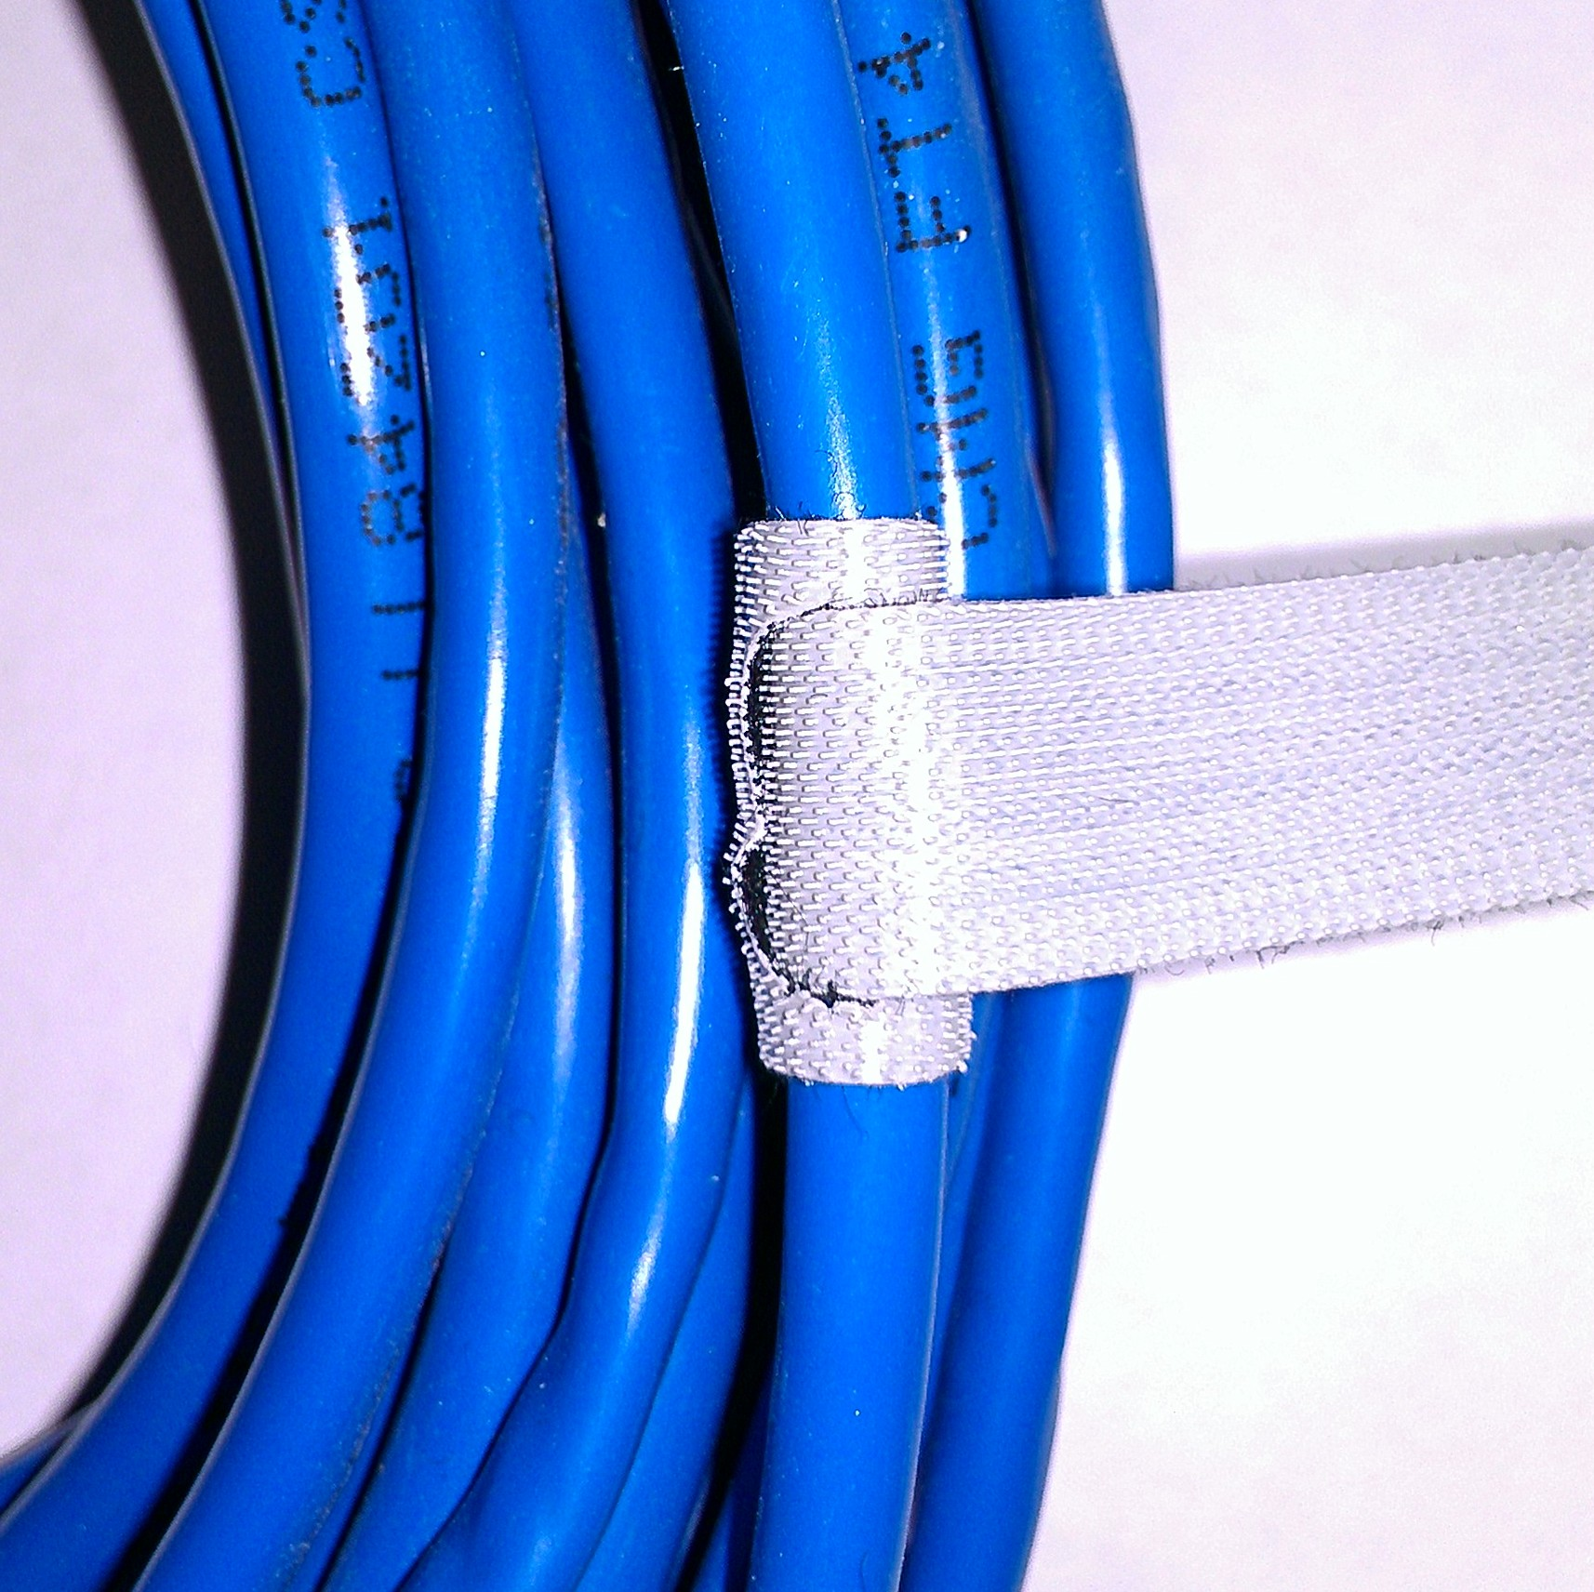
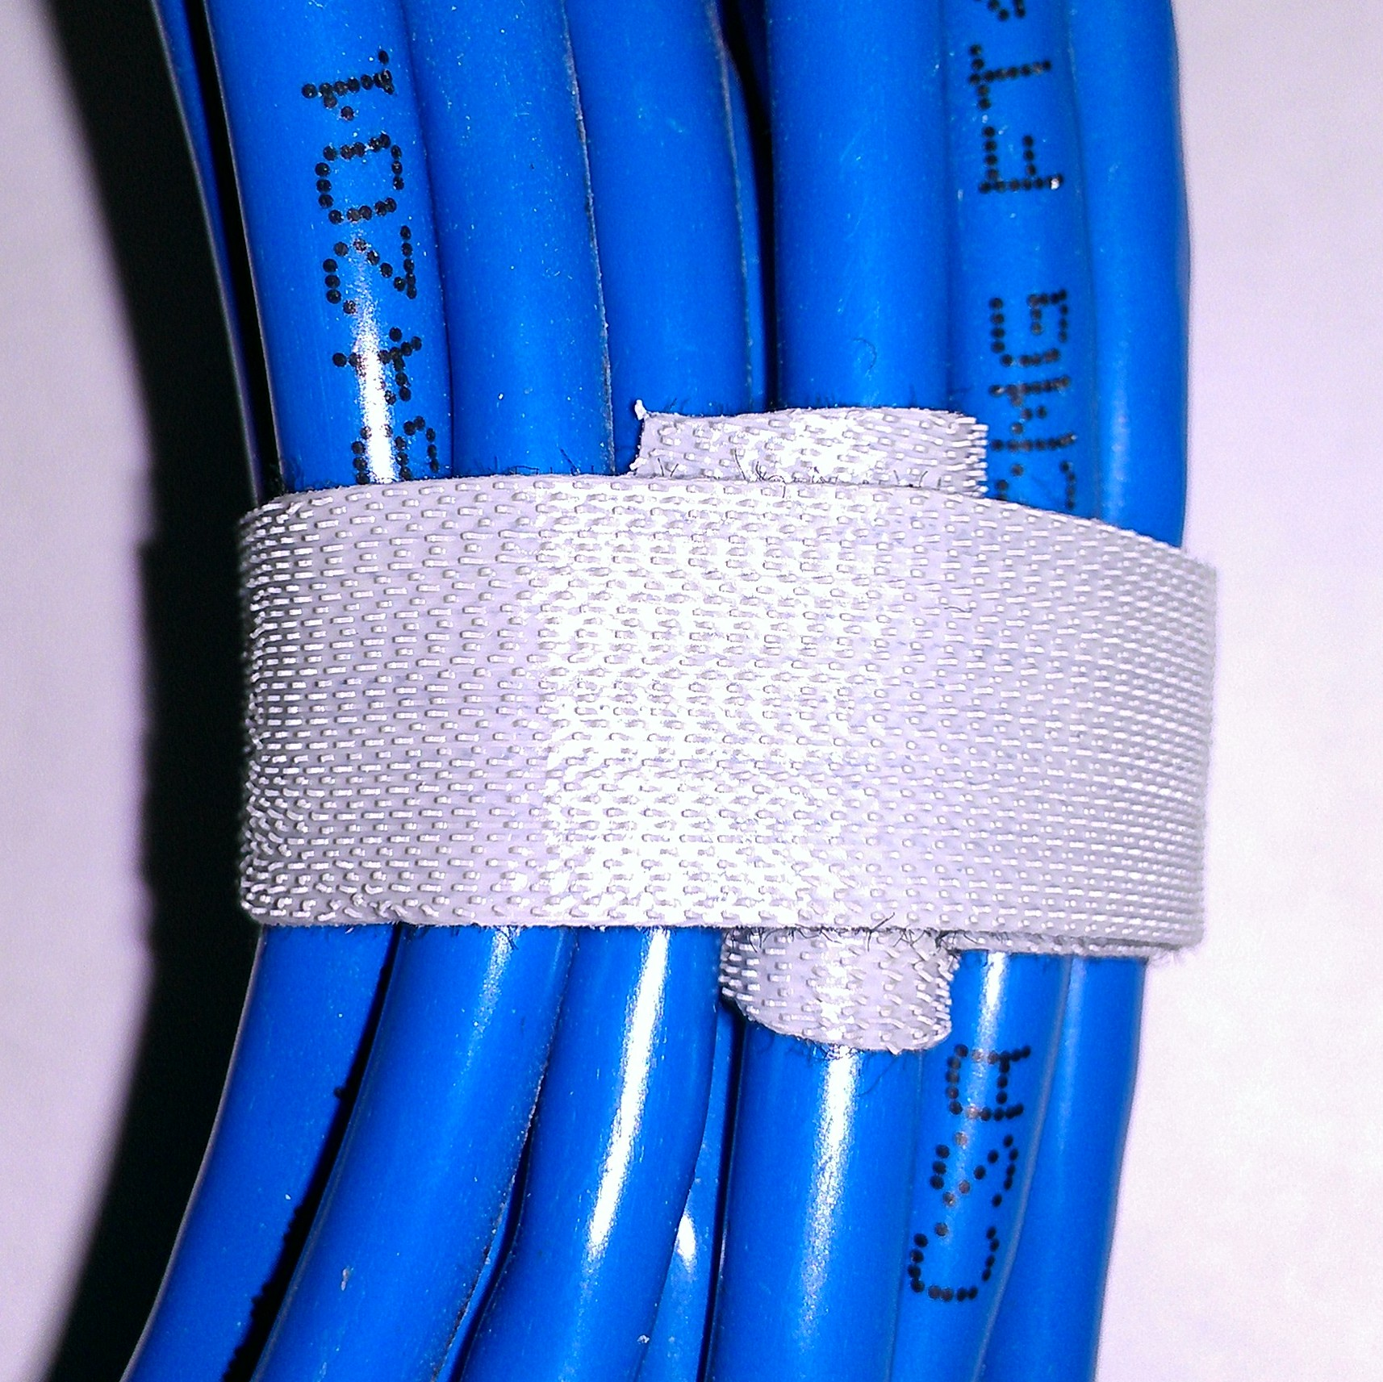
Velcro Cable Ties
Tight wraps
Secure around single cable
Then, wrap bundle

Slide 19
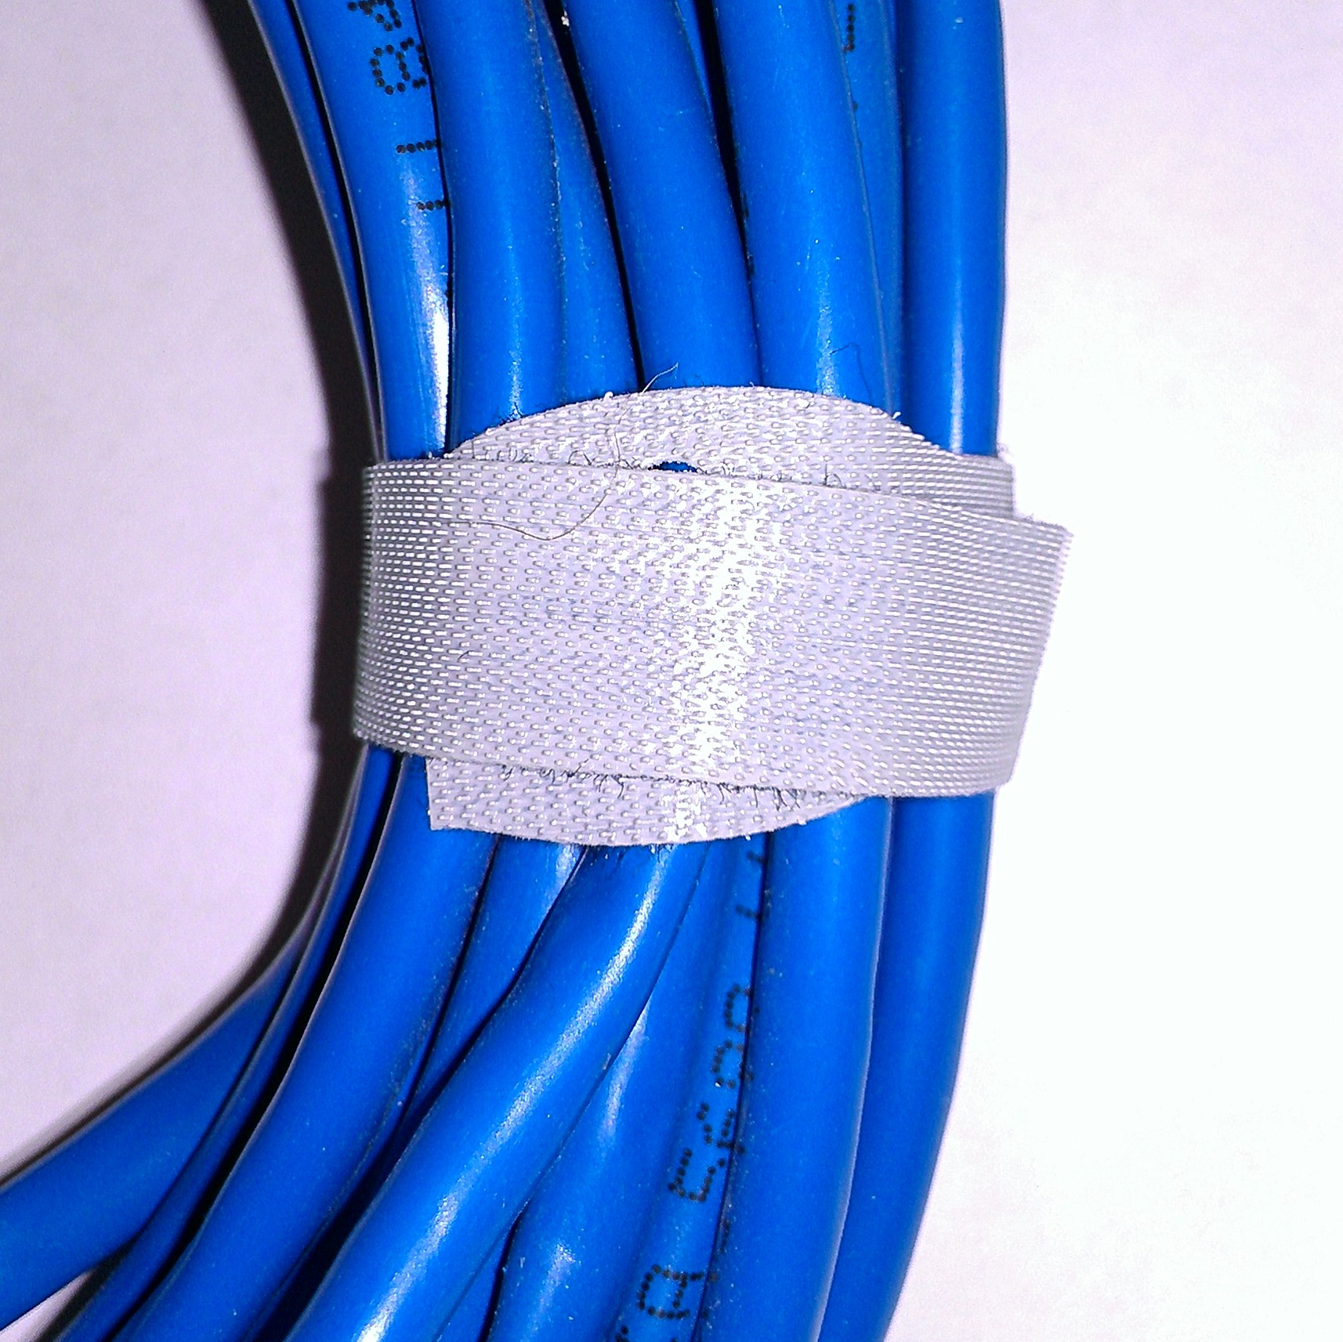
Velcro Cable Ties
Loose wraps
Secure around single cable
Then, wrap bundle

Slide 20
Power Budget

Slide 21
Power Budget
Cluster power density is trending upward quickly
Generally follows Moore’s Law (exponential)
But often more efficient idle power
Newer server rooms are trending to smaller areas with more power supplied

Slide 22
Power Budget
This Course
Various power sockets in subfloor
Various voltage and current ratings
Various types of power strips and PDUs (Power Distribution Units)
Has it’s own power and current ratings
You’ll need to figure out, given the equipment available, how to power your cluster safety

Slide 23
Power Budget
P = I * V
Appliances are typically rated by a maximum power load described by voltage and current
Power supplies have wide voltage inputs, but have a (nearly) static power load rating

Slide 24
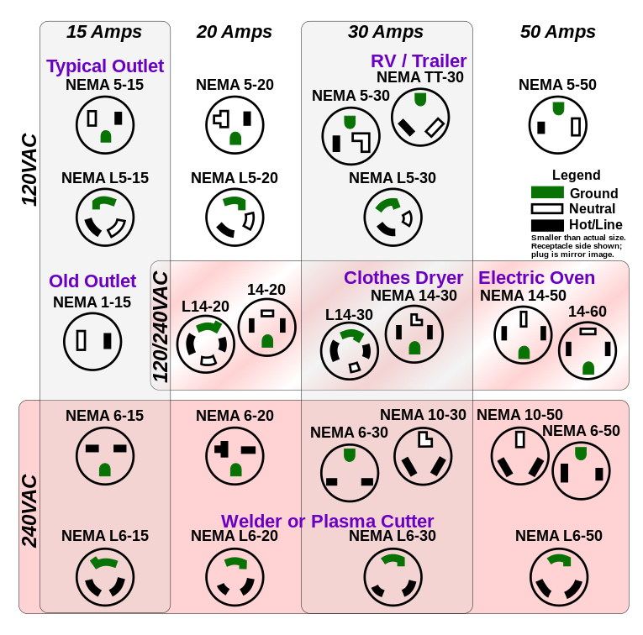
Power Budget
Plugs and Sockets

Slide 25
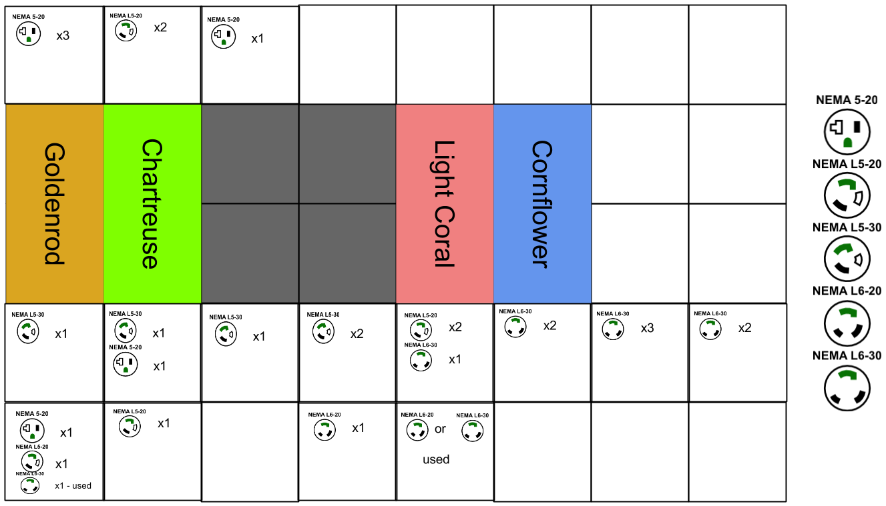
Saffron
Celadon
Vermilion
Cerulean

Slide 26
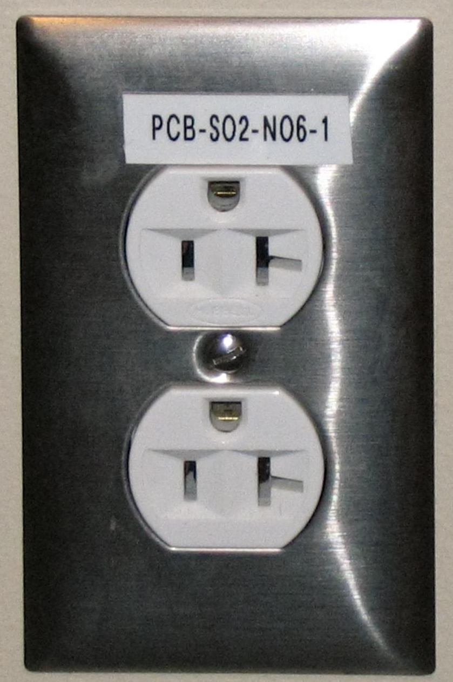
Power Budget
Breaker Circuit
You’ll see two 20A sockets on one 20A breaker circuit
DO NOT attempt to load at 40A!
Max of 20A for both sockets combined!

Slide 27
Power Budget
Supply vs. Draw
Maximum supply is the lowest power rating for a given supply chain
Maximum load is the sum of all power-consumer’s (servers, switches, etc.) ratings
GOAL: ensure that your maximum load does not exceed the maximum supply

Slide 28
Power Budget
Let’s work it through
P = IV
Power supplies rated at
100V 6A
240V 3A
Switches (Ethernet and Infiniband)
KVM units
Rack fans

Slide 29
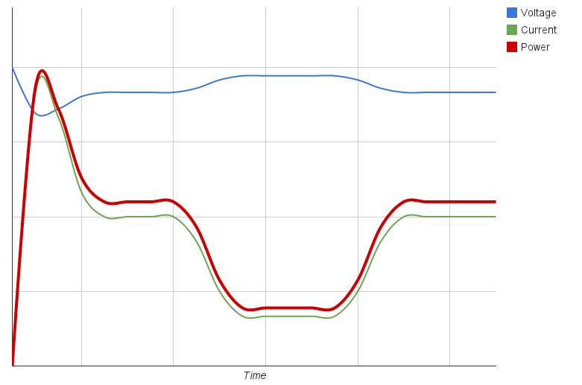
Power On
OS Boot
Idle
Job

Slide 30
Power Budget
Temporal Shifting of Power Draw
By staggering the power-on stage you can reduce the power spike on a PDU
What happens after a power outage?
What about a full-sized cluster?
Do we have to worry about the amount of power available from the power company?
Power spikes increase billing costs!

Slide 31
Power Budget
Design Considerations
What voltage would you supply to a new server room? Why
Does wire gauge matter? What about length? When do these matter?
What sockets would you use in a new design?

Slide 32
Summary

Slide 33
Summary
Server Assembly
Cable Installation
Power Budget

